Slide 1



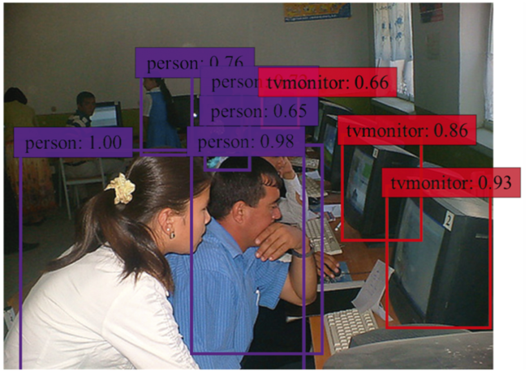

Object detection and tracking using single shot detector(SSD)
Name- Vansh Raina
Enrollment- 12202040501061
Batch-1D04
Guided by: Prof. Kinal Joshi

Slide 2
Project outline
1: Introduction
(a)Overview of Object Detection
(b)Purpose of the Project
(c)Expected Outcome
2: Analytics
(a)Hardware and Software Requirements
(b)Libraries Used: OpenCV, NumPy, Imutils
(c)GPU Acceleration: Using CUDA for Faster Processing
3: Model Deployment
(a)Choosing SSD with MobileNet
(b)Using OpenCV's Deep Neural Network (DNN) module
(c)Loading Pre-trained Caffe Model
4: Implementation Details
(a)Loading the SSD Model
(b)Processing Input Frames
(c)Image Resizing and Blob Creation
(d)Confidence Threshold for Object Detection
(e)Drawing Bounding Boxes and Labels
(f)Displaying Output Using cv2.imshow()
5: Result Analysis
(a)Performance Metrics: FPS Calculation
(b)Accuracy of Detection Based on Confidence Level
(c)Effect of GPU Acceleration on Speed
6: Future Work & Conclusion
(a)Enhancing the Model with Custom Training Data
(b)Improving Speed & Accuracy
(c)Deploying the Model for Real-world Applications
(d)Summary of Key Achievements

Slide 3
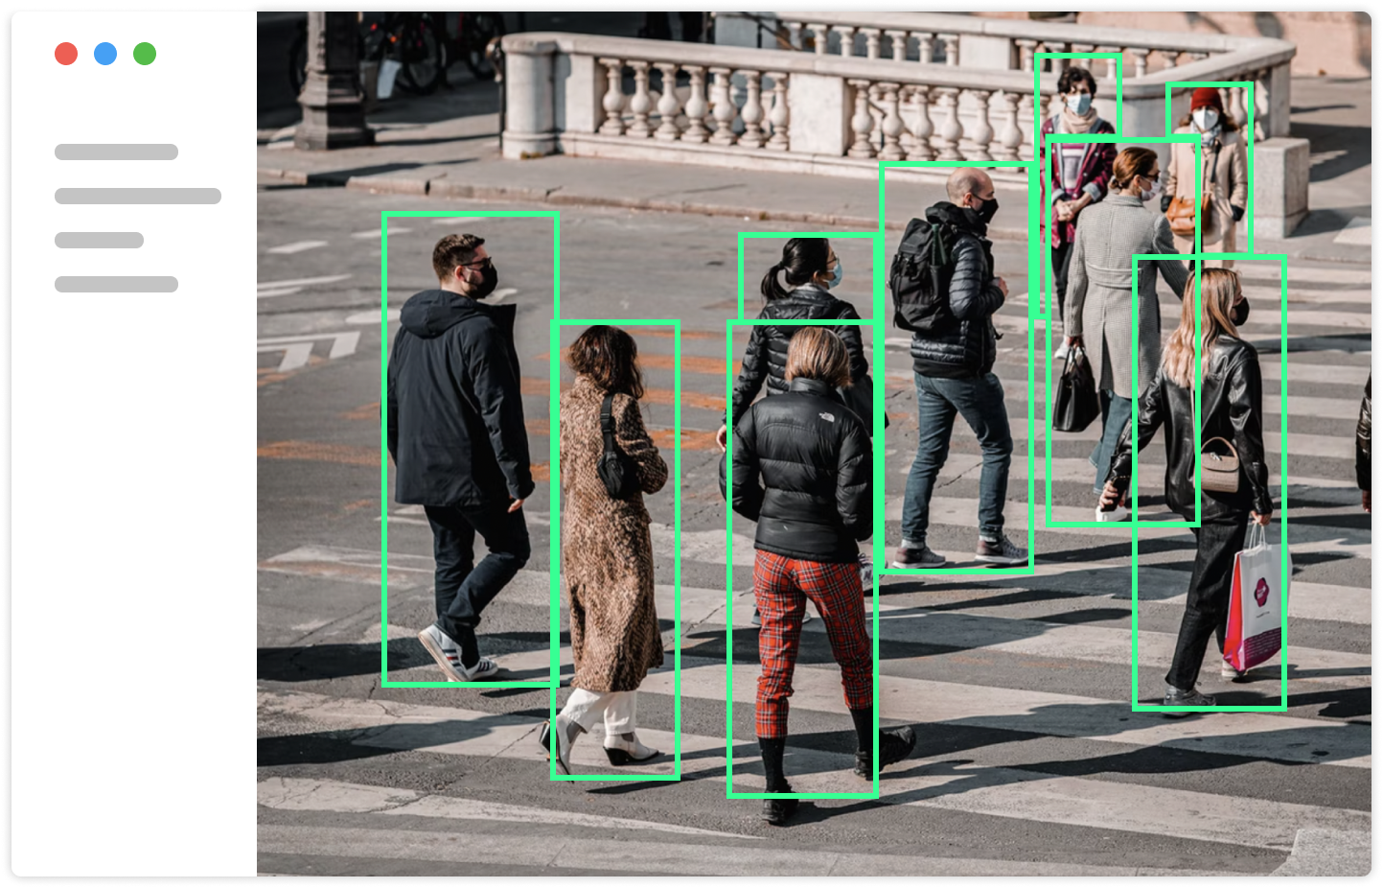
INTRODUCTION
(a) Overview of Object Detection
Object detection is a computer vision technique that identifies and locates objects within images or video frames. In this project, the SSD (Single Shot MultiBox Detector).It utilizes OpenCV's DNN module to load a pre-trained MobileNetSSD model, process frames, and draw bounding boxes around detected objects.
(b) Purpose of the Project
The main objective of this project is to implement a real-time object detection system using SSD with MobileNet. The project aims to:
Accurately detect and classify objects in images or video streams.
Achieve high-speed performance suitable for real-time applications.
Leverage GPU acceleration (CUDA) to enhance processing speed.
By utilizing OpenCV’s cv2.dnn.readNetFromCaffe(), the SSD model is loaded, and predictions are generated efficiently.
(c) Expected Outcome
Upon execution, the system should:
Detect objects in a live video feed or static images with bounding boxes and labels.
Maintain a good balance between detection speed and accuracy.
Display results with an optimized FPS (Frames Per Second) calculation to measure performance.
The performance is tracked using FPS calculations to analyze speed improvements with GPU acceleration.

Slide 4


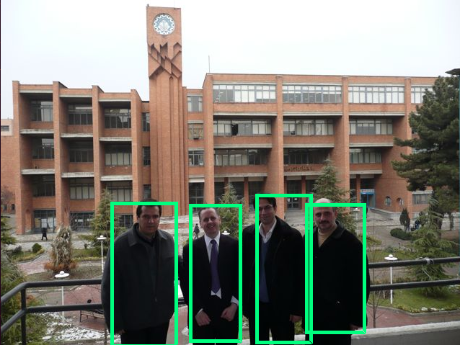
SYSTEM ANALYSIS
(a) Hardware and Software Requirements
Hardware Requirements:
Camera/Webcam (Optional): If real-time detection is needed
Software Requirements:
Operating System: Windows, Linux, or macOS
Python Version: 3.x
Libraries: OpenCV, NumPy, Imutils
Deep Learning Model: Pre-trained MobileNetSSD (Loaded using OpenCV DNN module)
This Model uses cv2.dnn.readNetFromCaffe() to load the SSD model and cv2.imshow() to display detection results, ensuring smooth real-time execution.
(b) Libraries Used: OpenCV, NumPy, Imutils
Several key libraries are used in the project for object detection and image processing:
Uses imutils.resize() for resizing frames before detection.
(c) GPU Acceleration: Using CUDA for Faster Processing
CUDA (Compute Unified Device Architecture) is NVIDIA's parallel computing platform that speeds up deep learning inference.

Slide 5
Model Deployment
Choosing SSD with MobileNet
SSD (Single Shot MultiBox Detector) is chosen for its speed and efficiency in real-time object detection. MobileNet is used as a lightweight backbone, making the model fast while maintaining accuracy. It implements SSD-MobileNet for detecting objects in video streams.
Using OpenCV's Deep Neural Network (DNN) Module
OpenCV's DNN module allows efficient deep learning model execution without heavy frameworks like TensorFlow.
Loading Pre-trained Caffe Model
The pre-trained SSD-MobileNet model is stored in Caffe format (.prototxt for architecture, .caffemodel for weights).
User Interface: Displaying Detection in Real-Time
The script processes video frames, detects objects, and displays results using OpenCV

Slide 6

IMPLIMENTATION
(a)Loading the SSD Model
The SSD-MobileNet model is pre-trained on dataset.The model consists of:
A .prototxt file (defines the network architecture).
A .caffemodel file (stores the trained weights).
(b) Processing Input Frames
Once the model is loaded, it processes frames from a live camera or a pre-recorded video.
If live_video = True, frames are captured from the webcam:
vs = cv2.VideoCapture(0)
If live_video = False, a video file is used instead:
vs = cv2.VideoCapture("video.mp4")
The uploaded script continuously reads frames, detects objects, and displays the results.
(c) Image Resizing and Blob Creation
Before passing frames to the SSD model, the image needs to be resized and converted into a blob (preprocessed input format for deep learning models).

Slide 7
Continued
(d) Confidence Threshold for Object Detection
The confidence threshold determines whether a detected object is valid or should be ignored. The uploaded Python file sets a threshold of 0.5 (50%):
confidence_level = 0.5
During detection, if the model’s confidence score for an object is above this threshold, it is considered a valid
(e) Drawing Bounding Boxes and Labels
Once an object is detected, a bounding box is drawn around it using OpenCV. The script extracts the object’s position and scales it to the frame size:
(f) Displaying Output Using cv2.imshow()
After detecting objects and drawing bounding boxes, the processed frame is displayed in a window using OpenCV’s

Slide 8
RESULT ANALYSIS
(a) Performance Metrics: FPS Calculation
Frames Per Second (FPS) is used to measure how quickly the object detection model processes frames. A higher FPS means smoother real-time detection.
(b) Accuracy of Detection Based on Confidence Level
The accuracy of detected objects depends on the confidence threshold set in the script
confidence_level = 0.5
Objects with a confidence score above 50% are considered valid:
By increasing the confidence level, false detections can be reduced, but some valid objects might be missed.
(c) Effect of GPU Acceleration on Speed
Using a CUDA-enabled GPU significantly improves detection speed by offloading computations from the CPU.

Slide 9
FUTURE WORK
(a) Enhancing the Model with Custom Training Data
The SSD model is pre-trained on a general dataset (COCO or Pascal VOC).
By using a custom dataset, the detection model can recognize specific objects with higher accuracy.
(b) Improving Speed & Accuracy
To enhance both speed and accuracy, several optimizations can be applied:
Use a Higher-Performance Backbone:
It uses MobileNet (lightweight and bit accurate).
Upgrading to a ResNet-based SSD can improve accuracy.
(c)Enable GPU Acceleration:
Running the model on GPU instead of CPU significantly improves FPS.

Slide 10
Continued
(c) Deploying the Model for Real-world Applications
Once the object detection model is working correctly, it can be deployed in real-world scenarios such as:
Surveillance & Security – Detect intruders or suspicious activities in CCTV footage.
Autonomous Vehicles – Identify pedestrians, traffic signs, and other vehicles.
Retail & Inventory Management – Automate product recognition and stock tracking.
Healthcare – Detect medical conditions from scans and X-rays.
(d) Summary of Key Achievements
Efficient Object Detection:
Detects multiple objects in live video or pre-recorded footage.
Uses OpenCV’s DNN module for fast inference.
Optimized Performance:
GPU acceleration with CUDA support improves speed.
Frame resizing and blob creation enhance processing efficiency.
User-Friendly Implementation:
Displays bounding boxes and labels on detected objects..

Slide 11
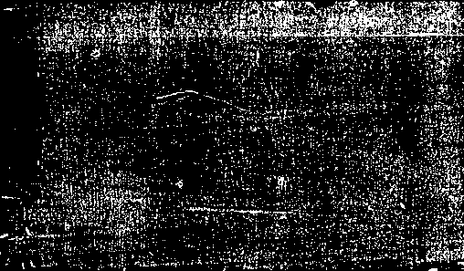

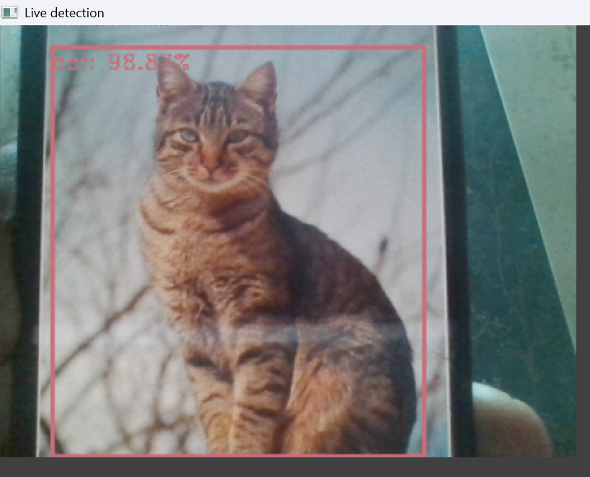
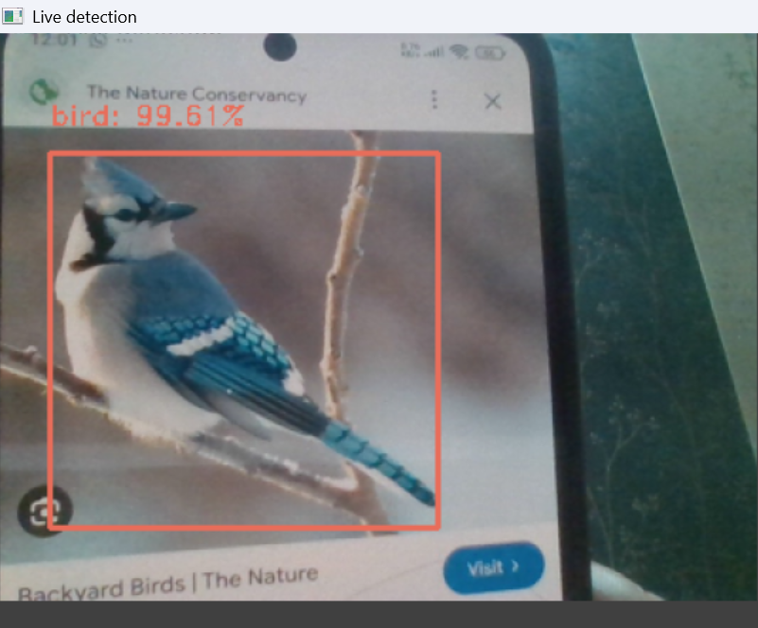
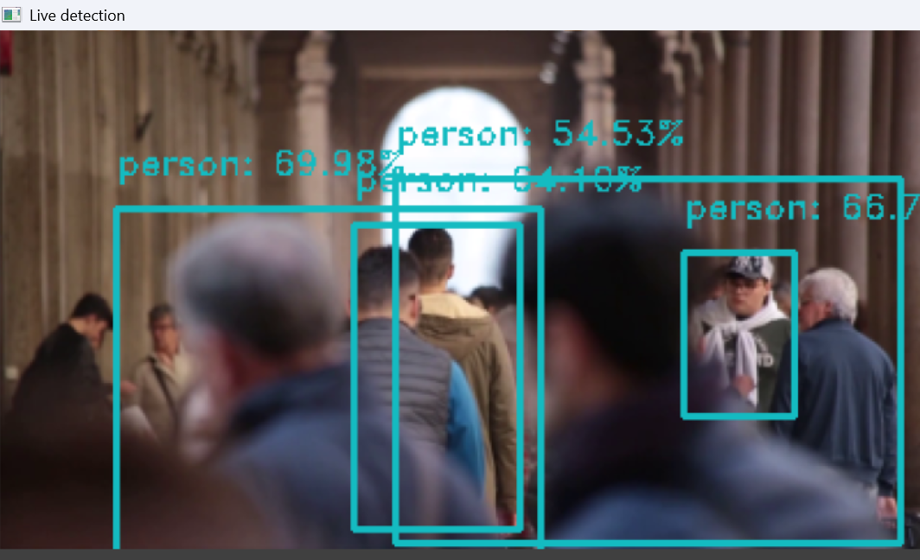
DETECTIONS DONE BY MODEL
Live Tracked
Tracked Through Video

Slide 12
cONCLUSION
The Project successfully implements real-time object detection using SSD-MobileNet. By leveraging OpenCV’s DNN module, it efficiently processes video frames, detects objects, and displays results with bounding boxes and labels.
Key takeaways from this project:
1. Fast and efficient detection using SSD, suitable for real-time applications.
2. Optimized performance with GPU acceleration (CUDA) to enhance speed.
3. Customizability for specific use cases by training on custom datasets.
4. With further enhancements, such as fine-tuning the model or deploying it on edge devices, this project can be extended for real-world applications like surveillance, autonomous systems, and retail automation.

Slide 13
Refrences
Liu, W., Anguelov, D., Erhan, D., Szegedy, C., Reed, S., Fu, C. Y., & Berg, A. C. (2016).
SSD: Single Shot MultiBox Detector.
Howard, A. G., Zhu, M., Chen, B., Kalenichenko, D., Wang, W., Weyand, T., & Adam, H. (2017).
This paper details the MobileNet backbone used in the Python script for lightweight detection.
OpenCV DNN Module Documentation:
https://docs.opencv.org/
For resizing and normalizing frames before passing them to the model:
https://docs.opencv.org/4.x/d6/d0f/group__dnn.html
MobileNet SSD Pre-trained Model:
Source:"ssd_files/MobileNetSSD_deploy.caffemodel")
https://developer.nvidia.com/cuda-zone
Redmon, J., Divvala, S., Girshick, R., & Farhadi, A. (2016).
You Only Look Once: Unified, Real-Time Object Detection (YOLO).
Ren, S., He, K., Girshick, R., & Sun, J. (2015).
OpenCV Object Detection Tutorials:
https://pyimagesearch.com/category/object-detection/

Slide 14
Thank you

